Slide 1


PASALA TEJA SAIKRISHNA
25th MAY 2024

Slide 2

Outline
Executive Summary
Introduction
Methodology
Results
Conclusion
Appendix

Slide 3
Executive Summary
Summary of Methodologies
Data Collection through SpaceX API
Data Collection with Web Scraping from Wikipedia
Data Wrangling
Exploratory Data Analysis with SQL
Exploratory Data Analysis with Data Visualization
Interactive Visual Analytics with Folium
Interactive Dashboard with Ploty Dash
Machine Learning Prediction
Summary of all results
Exploratory Data Analysis result
Interactive Visual Analytics in screenshots
Interactive Dashboard in screenshots
Predictive Analytics result

Slide 4
Introduction
Project background and context
SpaceX offers Falcon 9 launches at $62 million, a price significantly lower than competitors’ rates, which start at $165 million. The key to SpaceX’s pricing advantage is the reusability of the rocket’s first stage. Accurately predicting the first stage’s landing can help determine launch costs, providing crucial data for competitors aiming to outbid SpaceX.
Problems you want to find answers
How do variables such as payload mass, location of launch site and landing site, number of flights, rocket reusability and orbits affect the success of the first stage landing?
The rate of successful landings increase over the years?
The best algorithm that can be used for binary classification in this case?

Slide 5

Section 1

Slide 6
Methodology
Executive Summary
Data collection methodology:
The data was collected using a combination of the SpaceX API and web scraping techniques.
Perform data wrangling
Identified missing values within the dataset and implemented strategies to address them
Applied one-hot encoding to convert categorical features into a numerical format
Perform exploratory data analysis (EDA) using visualization and SQL
Perform interactive visual analytics using Folium and Plotly Dash
Perform predictive analysis using classification models
Constructing, fine-tuning, and rigorously evaluating classification models to optimize performance and achieve the most accurate outcomes

Slide 7
Data Collection
The data was collected using two methods:
SpaceX API
Request to the SpaceX API and get a .json file
Decode the response content as a Json using .json() and turn it into a Pandas dataframe using .json_normalize()
We then cleaned the data, checked for missing values and fill in missing values where necessary.
Web Scrapping
Perform an HTTP GET method to request the Falcon9 Launch HTML Wikipedia page, as an HTTP response
Create a BeautifulSoup object from the HTML response
Extract the relevant tables from the page
Create a data frame by parsing the launch HTML tables

Slide 8
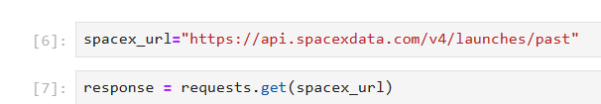
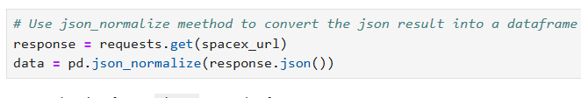
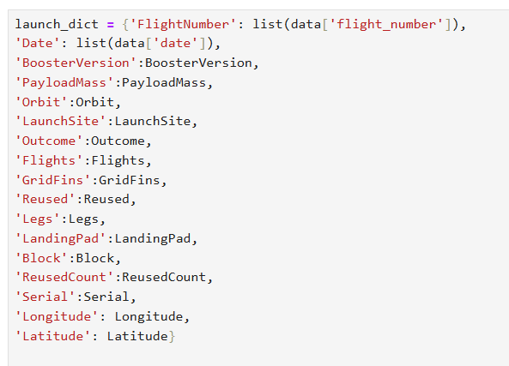
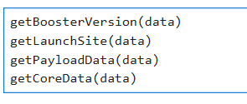
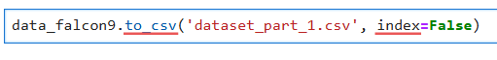
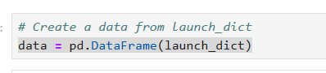
Data Collection – SpaceX API
1.Getting Response from API
2.Converting Response json file to DataFrame
4. Constructing our dataset using the data
3.Custom functions to clean data
5. Filter Dataframe and export to .csv file
GitHub URL : SpaceX Data Collection API

Slide 9
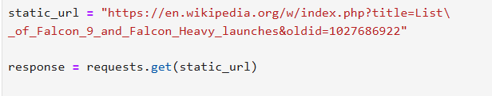
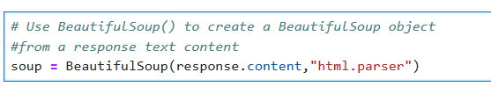
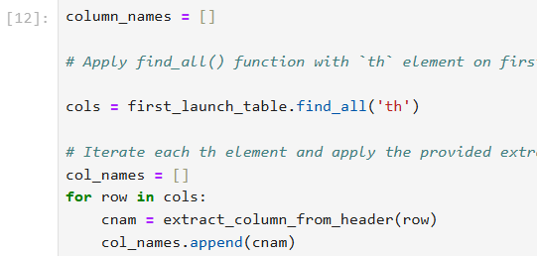
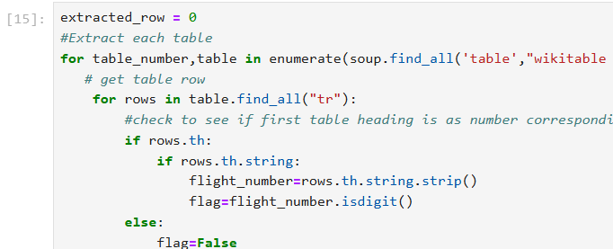
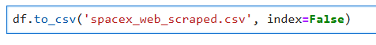
Data Collection – Web Scraping
1.Requesting Falcon 9 launch data from Wikipedia
2.Creating a BeautifulSoup object from the HTML response
4.Collecting the data by parsing HTML tables
into a dictionary (refer block 15 in notebook)
3.Extracting all column names from the HTML
table header (refer block 12 in notebook)
5.Creating a dataframe from the dictionary
6.Exporting the data to CSV
GitHub URL : SpaceX Data Collection with Web Scraping

Slide 10
Data Wrangling
In Data wrangling, we create a binary landing outcome variable “Class” from the categorical landing outcome.
True Ocean - successfully landed to a specific region of the ocean
False Ocean - unsuccessfully landed to a specific region of the ocean.
True RTLS - successfully landed to a ground pad
False RTLS - unsuccessfully landed to a ground pad.
True ASDS - successfully landed to a drone ship
False ASDS - unsuccessfully landed to a drone ship.
None ASDS and None None, these represent a failure to land.
We categorize the booster landing outcomes into a binary ‘Class’ training label, where a ‘1’ indicates a successful landing and a ‘0’ denotes an unsuccessful attempt.
Perform exploratory Data Analysis and determine Training Labels
Calculate the number of launches on each site
Calculate the number and occurrence of each orbit
Calculate the number and occurrence of mission outcome per orbit type
Create a landing outcome label from Outcome column
Exporting the data to CSV
GitHub URL : SpaceX Data Wrangling

Slide 11
EDA with Data Visualization
Charts were plotted:
Flight Number vs. Payload Mass (SP)
Flight Number vs. Launch Site (SP)
Payload Mass vs. Launch Site (SP)
Orbit Type vs. Success Rate (BC)
Flight Number vs. Orbit Type (SP)
Payload Mass vs Orbit Type (SP)
Success Rate Yearly Trend (LC)
Scatter Plots (SP): Scatter plots are graphical representations that display the relationship between two quantitative variables. Each point on the plot corresponds to an observation in the dataset.
Bar Charts (BC): Bar charts are used to compare quantities across different categories. By displaying bars of varying lengths, they visually represent the relationship and differences between discrete categories and associated values.
Line Charts (LC): Line charts are ideal for illustrating trends and changes over time. By connecting data points with a continuous line, they help in identifying upward or downward trends.
GitHub URL : SpaceX EDA with Visualization

Slide 12
EDA with SQL
Summary of SQL Queries Performed:
Display the names of the unique launch sites in the space mission
Display 5 records where launch sites begin with the string 'CCA'
Display the total payload mass carried by boosters launched by NASA (CRS)
Display average payload mass carried by booster version F9 v1.1
List the date when the first succesful landing outcome in ground pad was acheived
List the names of the boosters which have success in drone ship and have payload mass greater than 4000 but less than 6000
List the total number of successful and failure mission outcomes
List the names of the booster_versions which have carried the maximum payload mass
List the records which will display the month names, failure landing_outcomes in drone ship ,booster versions, launch_site for the months in year 2015
Rank the count of landing outcomes (such as Failure (drone ship) or Success (ground pad)) between the date 2010-06-04 and 2017-03-20, in descending order
GitHub URL : SpaceX EDA with SQL

Slide 13
Build an Interactive Map with Folium
Adding Markers:
We’ve successfully added a marker for the NASA Johnson Space Center, complete with a circle, popup label, and text label, using its precise latitude and longitude coordinates. This serves as our initial reference point for the map.
Building upon this, we’ve also incorporated markers for various launch sites. Each marker is designed to provide a comprehensive view of the site’s geographical context and its strategic location relative to the Equator and coastal lines. Here’s what we’ve included for each site:
Circle: A visual representation of the surrounding area, giving viewers a sense of scale and location.
Popup Label: An interactive element that offers detailed information about the launch site.
Text Label: A clear and concise label that identifies each launch site by name directly on the map.
GitHub URL : SpaceX_Interactive Visual Analytics with Folium

Slide 14
Build an Interactive Map with Folium
Color-Coded Success and Failure:
To distinguish success rates, we’ve color-coded the markers:
Green: Represents successful launches.
Red: Indicates failed launches.
By analyzing these markers, viewers can identify which launch sites have relatively high success rates.
Marker Clusters for Launch Site:
To maintain visual clarity, we’ve implemented Marker Clusters. Even when multiple markers are close together, the map remains organized.
Distance Visualization to Key Infrastructure:
We’ve taken it a step further by adding colored lines to represent distances between each launch site and nearby infrastructure:
Railways: Highlighting transportation connectivity.
Highways: Indicating accessibility.
Coastlines: Emphasizing proximity to water bodies.
Closest Cities: Showing urban centers in the vicinity.
GitHub URL : SpaceX_Interactive Visual Analytics with Folium

Slide 15
Build a Dashboard with Plotly Dash
Dropdown List of Launch Sites
Implemented an interactive dropdown menu to facilitate the selection of a Launch Site, enhancing the user interface for streamlined operations.
Creation of Pie Chart
Integrated a dynamic pie chart to display the aggregate count of successful launches across all sites, and a comparative analysis of Success versus Failure rates for individual Launch Sites upon selection
Payload Mass Range Slider
Enhanced the data analysis interface with an interactive slider for precise payload range selection, optimizing user engagement and data exploration
Payload Mass vs. Success Rate Scatter Chart
Implemented a scatter chart to effectively illustrate the correlation between payload mass and launch success rates across various booster versions, providing a clear visual analysis of the dataset
GitHub URL : SpaceX Interactive Dashboard with Ploty Dash

Slide 16
Predictive Analysis (Classification)
Create a NumPy array from the column ‘Class’ in dataframe
Standardize and transform the data in X then reassign it to self
Use the function train_test_split to split the data X and Y into training and test data
Create a GridSearchCV object with cv = 10 to find the best parameters for each algorithm
Finding the method
that performs best by
examining the accuracy
Examining the
confusion matrix
for all models
Calculating the
accuracy on the test
data using the
method .score()
for all models
Applying GridSearchCV on Logistic Reg, SVM, Decision Tree and KNN models
GitHub URL : SpaceX Machine Learning Prediction

Slide 17
Results
Exploratory data analysis results
Interactive analytics demo in screenshots
Predictive analysis results

Slide 18

Section 2

Slide 19
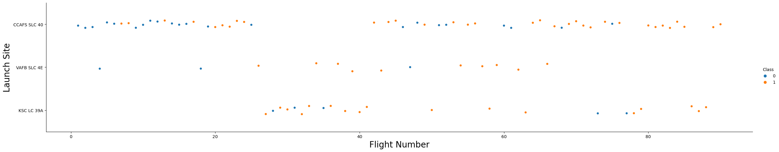
Flight Number vs. Launch Site
Initial Launch Outcomes: There was a clear trend observed in the early stages of the space program where the earliest flights encountered failures. However, as the program matured and technology advanced, the most recent flights have been consistently successful.
Launch Site Distribution: The CCAFS SLC 40 launch site has been a pivotal location for space endeavors, accounting for approximately 50% of all launches. This site has played a significant role in the history and development of space exploration.
Success Rates by Site: When comparing launch sites, VAFB SLC 4E and KSC LC 39A stand out with notably higher success rates. These sites have demonstrated a reliable track record, contributing to the overall success of the space program.
Progressive Improvement: Analyzing the data trends, it’s reasonable to infer that each subsequent launch is more likely to succeed than the previous one. This progressive improvement can be attributed to the accumulation of knowledge, experience, and technological advancements in aerospace engineering

Slide 20
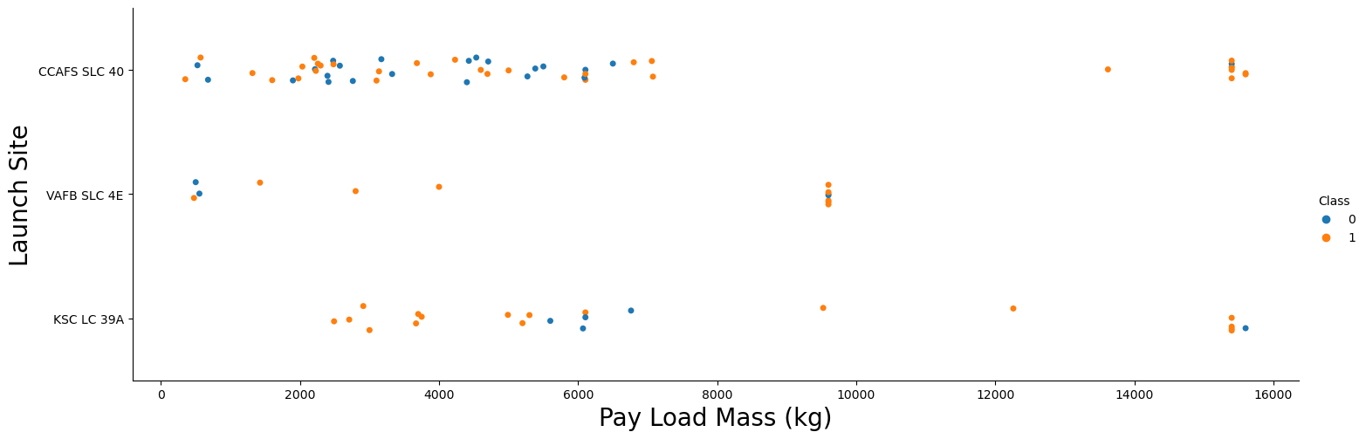
Payload vs. Launch Site
Payload Mass vs. Success Rate:
There is a clear trend: higher payload mass tends to correlate with a higher success rate for rocket launches.
Most launches with a payload mass exceeding 7000 kg were successful.
KSC LC 39A: For payload mass under 5500 kg, it boasts an impressive 100% success rate

Slide 21
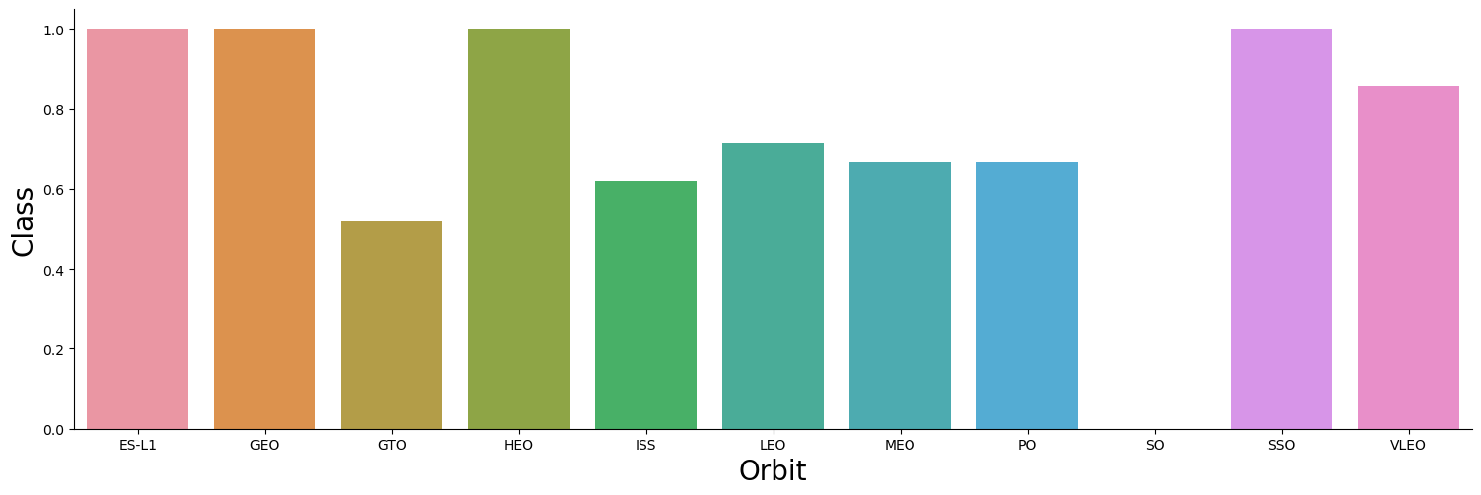
Success Rate vs. Orbit Type
Orbits with 100% Success Rate: ES-L1, GEO, HEO, SSO. These orbits have demonstrated a flawless track record in mission success.
Orbits with 0% Success Rate: SO (Suborbital)
Orbits with Variable Success Rates (50% - 85%):GTO, ISS, LEO, MEO, PO. These orbits show a moderate level of success, reflecting a mix of mission complexities and varying degrees of technical challenges

Slide 22
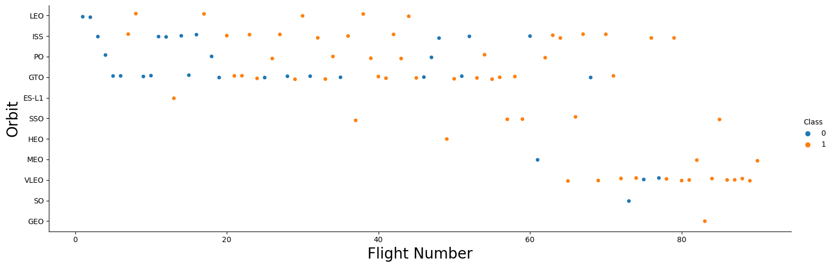
Flight Number vs. Orbit Type
LEO - Success Correlation:
In LEO, there is a positive correlation between the number of flights and mission success.
This suggests that frequent flights may contribute to higher success rates, possibly due to improved operational experience and refined technology over time.
GTO - Lack of Correlation:
Contrarily, in the GTO orbit, the number of flights does not appear to have a discernible impact on mission success.
This indicates that factors other than flight frequency, such as technical complexities or mission-specific challenges, play a more significant role in determining success in GTO missions

Slide 23
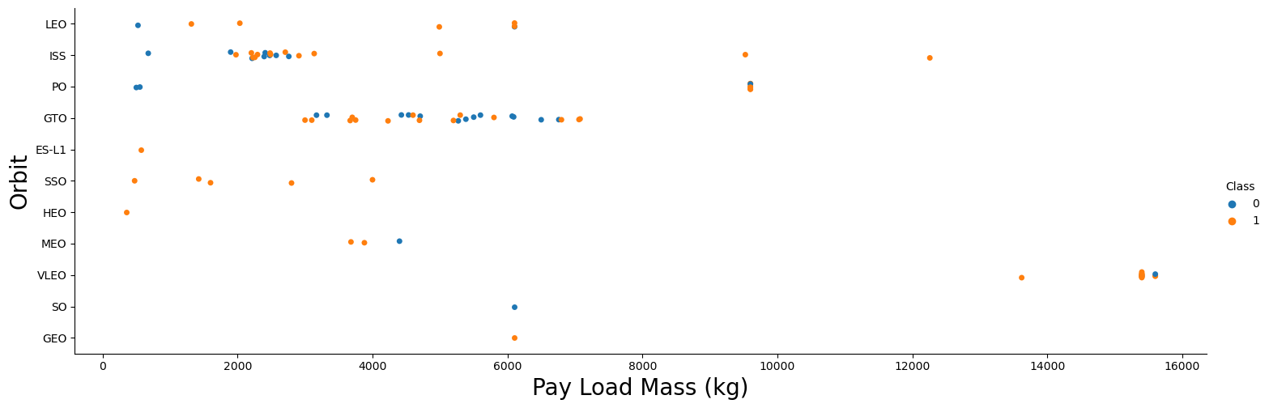
Payload vs. Orbit Type
GTO (Geostationary Transfer Orbit): There seems to be no observable correlation between the payload mass and the success rate for missions to GTO. This suggests that success in this orbit may depend more on other factors, such as technical specifications or mission design.
ISS (International Space Station) Orbit: The ISS orbit accommodates a diverse range of payload masses and maintains a high success rate. This versatility reflects the extensive experience and robust infrastructure supporting ISS missions.
SO (Suborbital) and GEO (Geostationary Earth Orbit): Missions to these orbits are less frequent. The limited number of launches could be due to specific mission requirements or the complexity associated with these orbits.

Slide 24
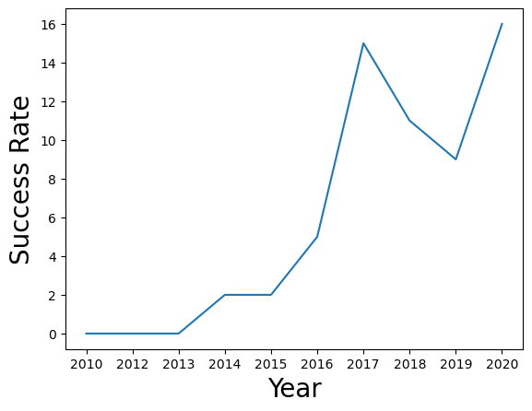
Launch Success Yearly Trend
Trend in Success Rate:
The success rate for launches began to climb in 2013 and continued to rise through 2020. This upward trend reflects a period of significant advancements and optimizations in space technology.
Initial Years of Development:
The initial three years appear to have been a critical phase of adjustment and technological refinement. This period likely involved iterative improvements and learning from early challenges, contributing to the later success.

Slide 25


Slide 26
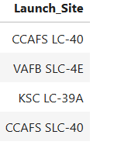
All Launch Site Names
Names of the unique launch sites in the space mission
Unique Launch Site Selection:
The dataset is refined by extracting distinct “launch_site” values, ensuring that each launch site is represented only once

Slide 27
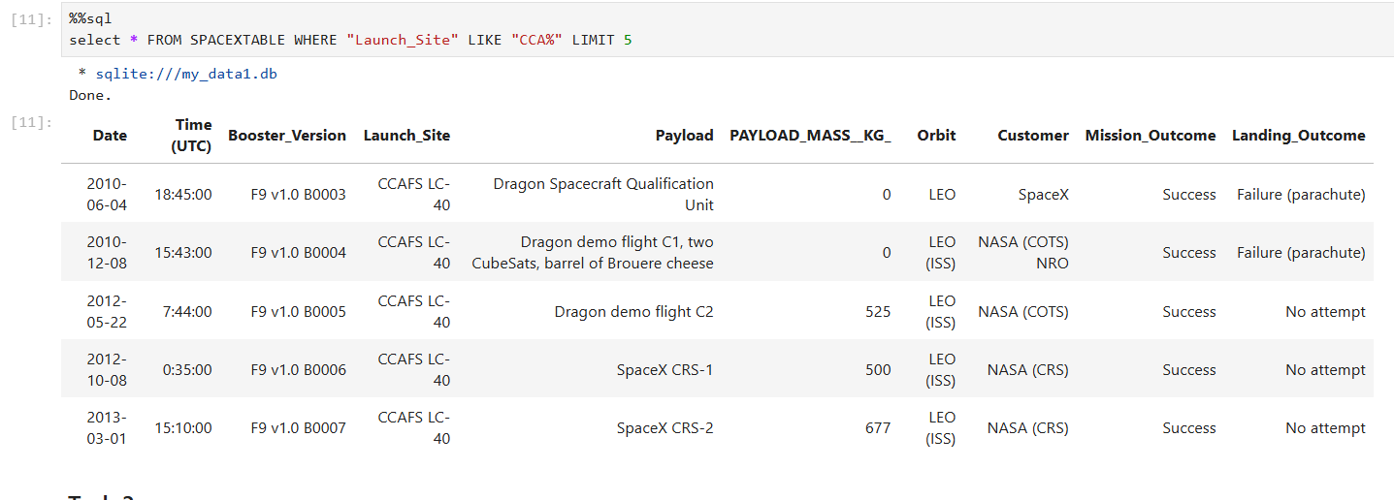
Launch Site Names Begin with 'CCA'
Display 5 records where launch sites begin with the string 'CCA’
This query is designed to efficiently fetch the first 5 records from the launch_data table where the launch_site values begin with ‘CCA’. The LIKE operator is used to match the specified pattern, and the LIMIT clause restricts the output to a manageable number of records.

Slide 28
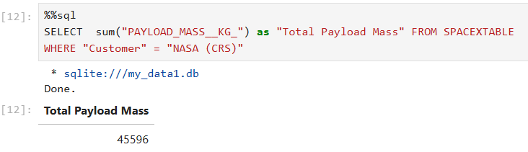
Total Payload Mass
The total payload carried by boosters from NASA
Total Payload Mass for NASA (CRS) Missions:
The cumulative payload mass transported by boosters on NASA’s Commercial Resupply Services (CRS) missions can be displayed using a SQL query using sum function

Slide 29
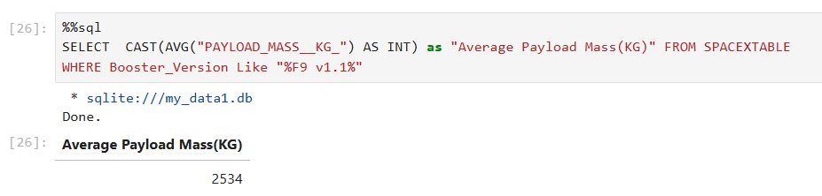
Average Payload Mass by F9 v1.1
Average payload mass carried by booster version F9 v1.1
Average Payload Mass for F9 v1.1:
The average payload mass transported by the F9 v1.1 booster is approximately 2534 kg. This value represents the typical payload capacity of this specific version of the Falcon 9 rocket.

Slide 30
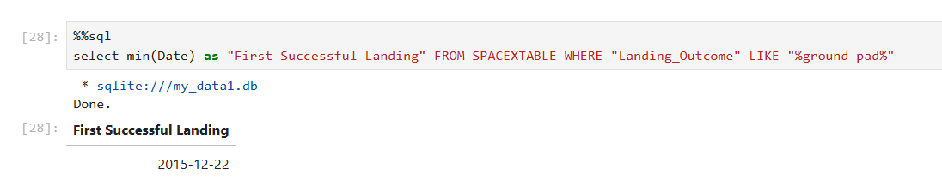
First Successful Ground Landing Date
Date of the first successful landing outcome on ground pad
Historic First Successful Landing:
On December 22, 2015, SpaceX achieved a groundbreaking milestone by successfully landing the first stage of its Falcon 9 rocket vertically. This achievement marked the inaugural instance of a rocket booster returning to Earth intact during an orbital launch

Slide 31
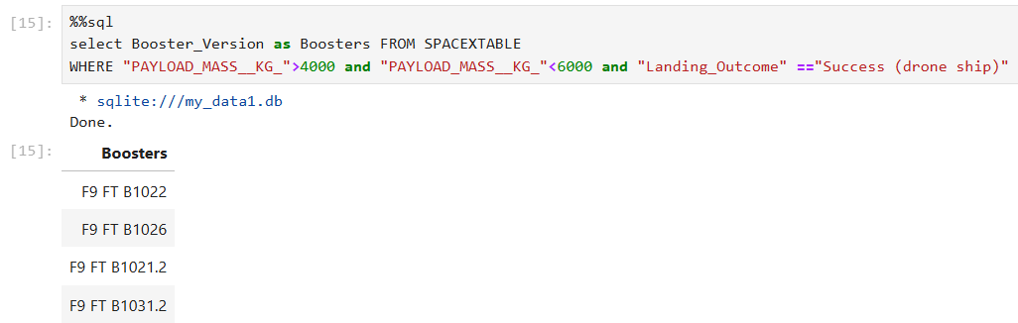
Successful Drone Ship Landing with Payload between 4000 and 6000
Based on the filters provided, the following four booster versions satisfy the conditions:
List of names of boosters which have successfully landed on drone ship and had payload mass greater than 4000 but less than 6000

Slide 32
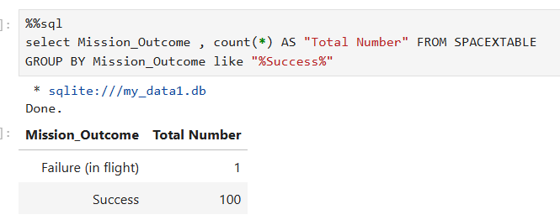
Total Number of Successful and Failure Mission Outcomes
The total number of successful and failure mission outcomes
This query will:
Select records from SPACEXTABLE.
Filter the results to only include rows where Mission_Outcome contains the string “Success”.
Count the total number of these filtered results.
Group the results by Mission_Outcome

Slide 33
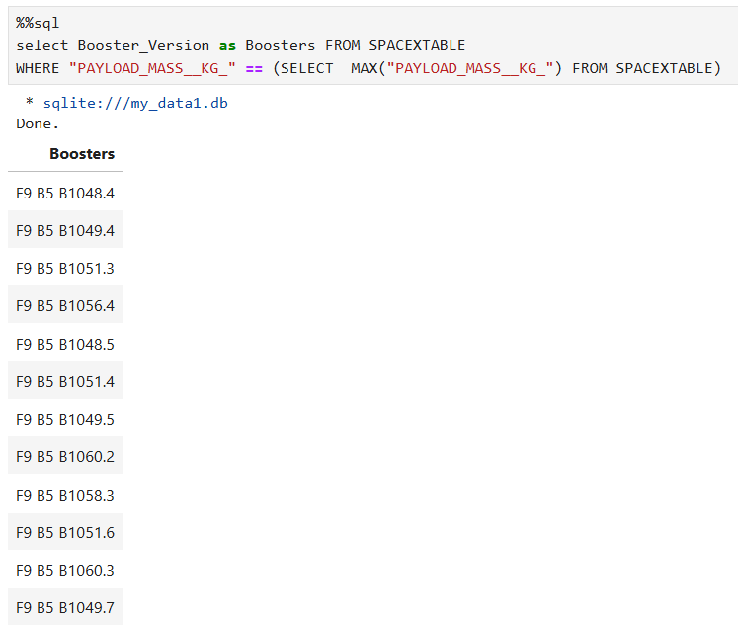
Boosters Carried Maximum Payload
This query will return the booster versions that have carried the heaviest payload, according to the SPACEXTABLE Table

Slide 34
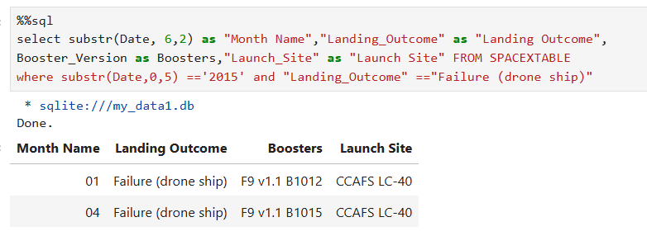
2015 Launch Records
List of failed landing_outcomes in drone ship, their booster versions, and launch site names in year 2015
In 2015, there were two failed landing outcomes on a drone ship:
Booster Version: F9 v1.1 B1012
Launch Site: Cape Canaveral1
Booster Version: F9 v1.1 B1015
Launch Site: Cape Canaveral

Slide 35
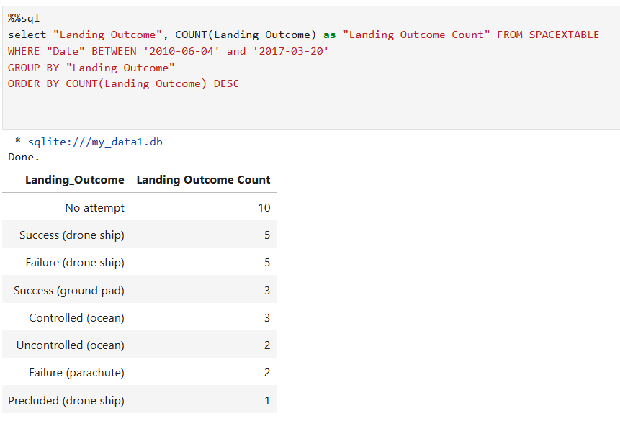
Rank Landing Outcomes Between 2010-06-04 and 2017-03-20
Rank the count of landing outcomes (such as Failure (drone ship) or Success (ground pad)) between the date 2010-06-04 and 2017-03-20, in descending order
This query will group the landing outcomes, count the number of occurrences for each outcome, and then order the results in descending order based on the count. You’ll get a ranked list of outcomes, from the most frequent to the least frequent within the specified date range.

Slide 36

Section 3

Slide 37
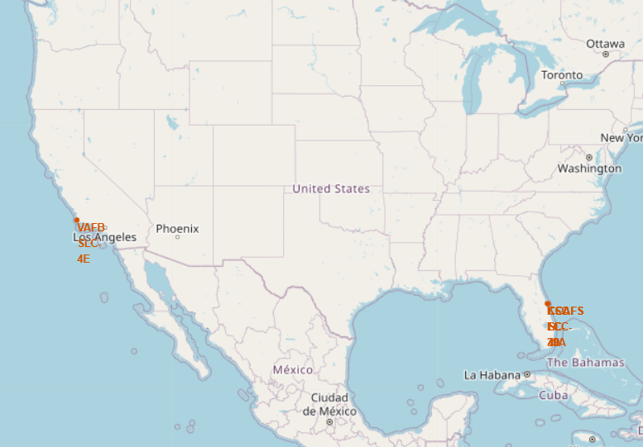
All Launch Sites Location Markers on a global map
Proximity to the Equator line:
Launching rockets from near the Equator provides an additional boost due to the rotational speed of Earth.
Launching eastward from the Equator ensures that any debris or malfunctioning stages fall into the ocean
Proximity to the Equator leads to a substantial increase in payload capacity.
Very Close Proximity To The Coast:
Coastal locations allow for launches over the ocean, reducing the risk of debris falling over populated areas in case of a launch failure.
Being near the coast provides more options for the rocket’s flight path.
Proximity to the coast facilitates easier transportation by sea, which is often more practical and cost-effective than land transport.
Launches can have significant environmental impacts, such as noise and pollution. Coastal sites help mitigate these effects by directing them over the ocean.

Slide 38
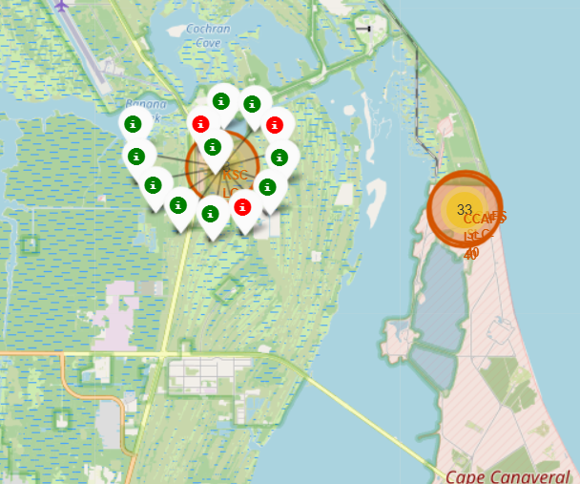
Color Labeled Launch Records
Color-labeled markers to identify launch sites based on their success rates:
Green Marker: Represents successful launches.
Red Marker: Represents failed launches.
SpaceX’s Falcon 9 and Falcon Heavy rockets frequently lift off from LC-39A. These rockets have achieved an impressive success rate, delivering payloads to orbit, launching satellites, and supporting scientific missions

Slide 39
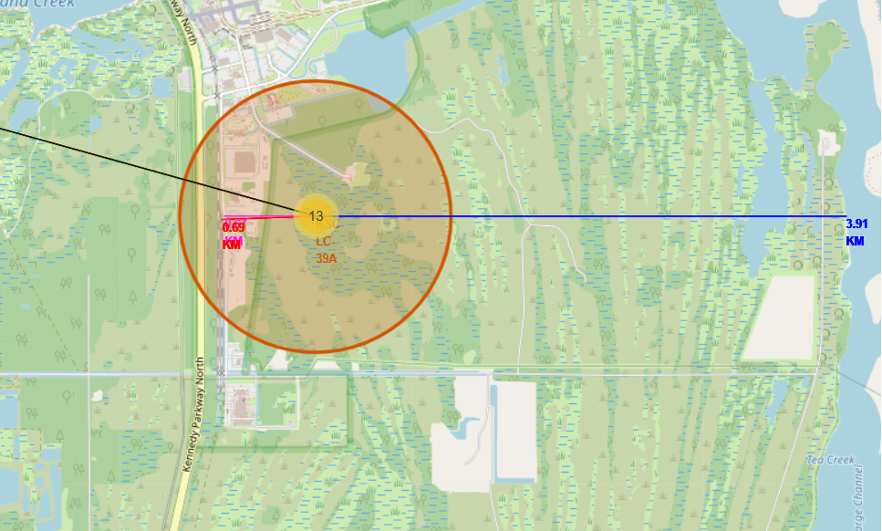
Distances Between A Launch Site To Its Proximities
Launch Site KSC LC-39A Close Proximity
Railway line – 0.69 KM
Highway – 0.61 KM
Coast – 3.91KM
Nearest City – 16.31 KM (Titusville)
Launch Site is closer to transportation and farther to city due to a failed rocket, can indeed cover distances of 15-20 kilometers in just a matter of seconds

Slide 40

Section 4

Slide 41
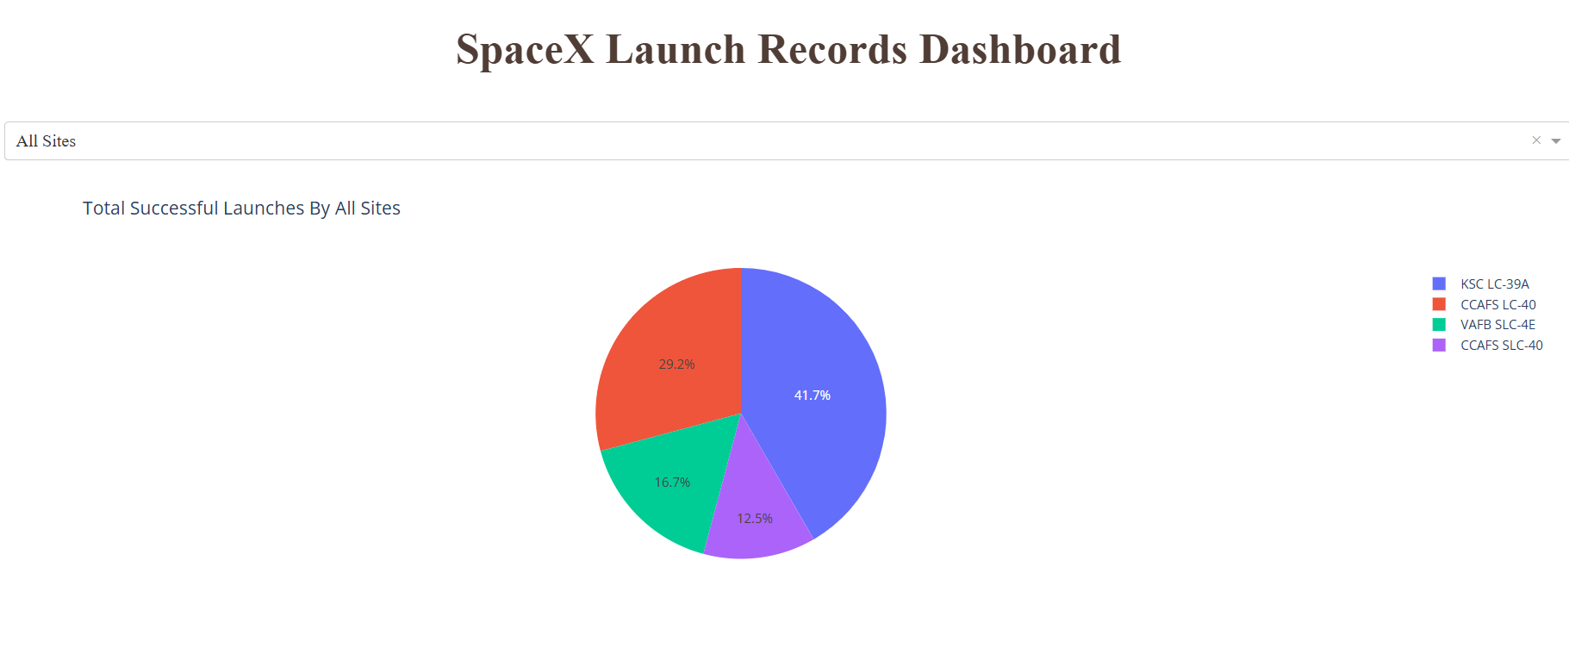
Successful Launches of All Launch Sites
The chart unmistakably highlights that KSC LC-39A stands out with the most successful launches of all launch sites

Slide 42
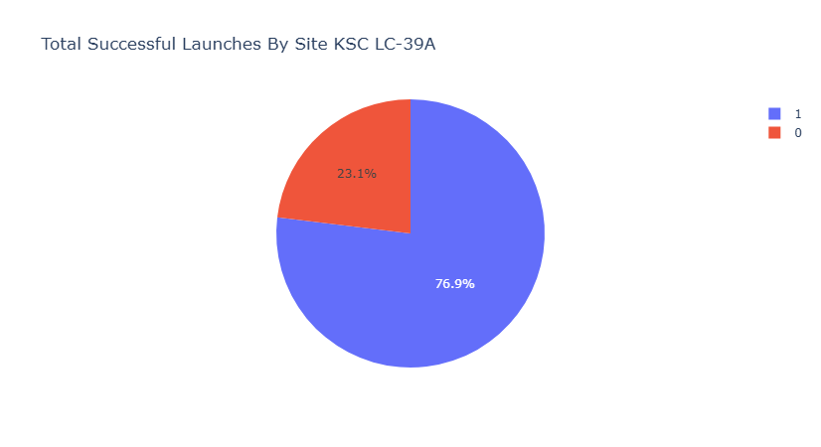
Launch Site With Highest Launch Success Ratio
Kennedy Space Center Launch Complex 39A (KSC LC-39A) boasts an impressive launch success rate of 76.9%. Let’s break down the numbers:
Successful Landings: 10
Failed Landings: 3

Slide 43
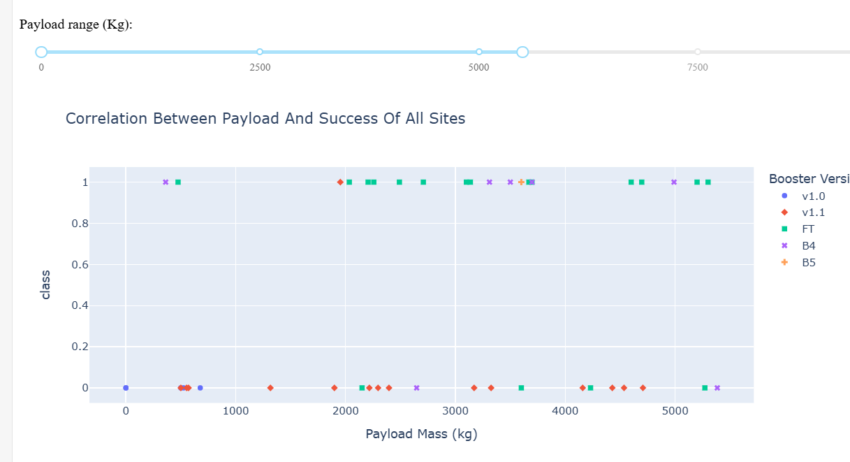
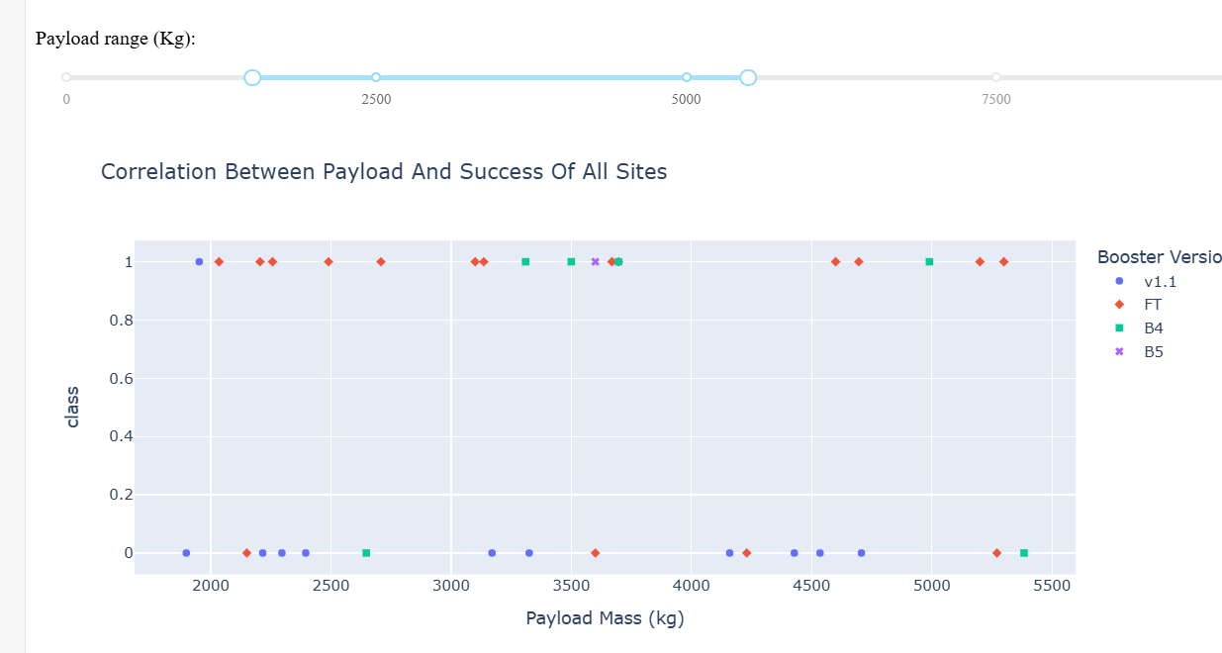
Payload Mass vs. Launch Outcome for all sites
Payloads under 6,000kg combined with Falcon 9 Full Thrust (FT) boosters indeed form a highly successful pairing for space missions
Payloads between 2000 and 5500 kg have the highest success rate suggests a sweet spot in payload capacity for launch vehicles.

Slide 44

Section 5

Slide 45
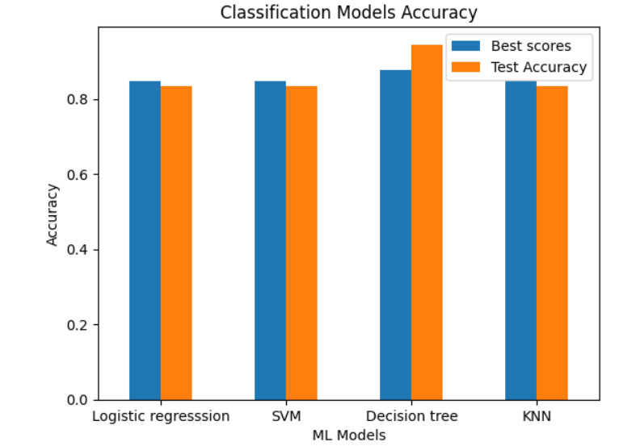
Classification Accuracy
Four classification models were tested, and their accuracies are plotted beside.
The model with the highest classification accuracy is Decision Tree Classifier, which has accuracies over than 94%.

Slide 46
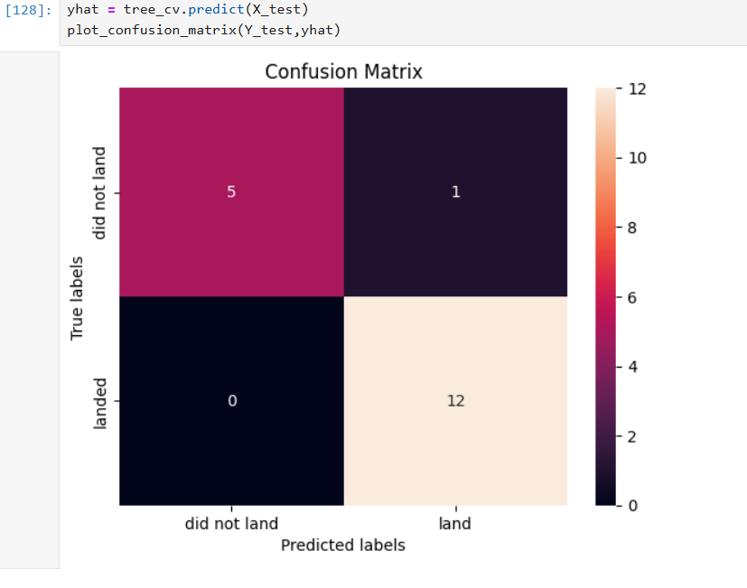
Confusion Matrix
Show the confusion matrix of the Decision Tree Classifier
This model has more true outcome than the fale one
The sum of TN & Tp is 17
Accuracy = (TP + TN) / (TP + TN + FP + FN)
Accuracy = 17/18 = 94%

Slide 47
Conclusions
Different data sources were analyzed, refining conclusions along the process
The strategic placement of most launch sites near the Equator and their close proximity to the coast play pivotal roles in space exploration
KSC LC-39A stands out as the pinnacle of launch success among all sites with a success rate of 77%, it surpasses other launch sites in terms of reliability and efficiency
The success rate of space launches has indeed been on an upward trajectory.
The orbits ES-L1, GEO, HEO, and SSO have achieved a remarkable 100% success rate in terms of landing outcomes
Payload mass plays a crucial role in determining mission success.
While the majority of missions have historically achieved success, the precision in landing outcomes has notably improved over time. This evolution is attributed to advancements in rocket technology, enhanced understanding of aerodynamics, and the development of sophisticated control systems.
The Decision Tree Classifier serves as a powerful tool for predicting successful landings and optimizing profits in the aerospace industry.

Slide 48
Appendix
Folium file can be viewed in nbviewer by pasting link
“close.csv” contains Latitude and Longitude of close proximities like city, railway, highway.
Dashboard application done in Jupyter notebook

Slide 49


